Slide 1
Development of Microcontroller Systems
1. Distinguish between components and tools used in the microcontroller system.

Slide 2
Activity
What is the microcontroller ?
What does it contain ?
Why do we use it ?
What makes microcontrollers different from PCs?

Slide 3
Microcontrollers
Microcontrollers are small, self-contained computer systems that are designed to control various electronic devices and systems.
They are essentially a type of microprocessor that include
Central Processing Unit (CPU)
memory
input/output (I/O) peripherals; such as timers, analog-to-digital converters, and communication interfaces.

Slide 4
Over the years, as technology advanced, microcontrollers have become
smaller
more powerful
less expensive
Microcontrollers are used in a wide variety of devices and systems, including:
Automobiles
medical equipment
consumer electronics,
children’s toys

Slide 5
They are often used to
control the behavior of electronic systems, such as turning lights on and off
regulating the temperature of a room.
Microcontrollers can also be used to read data from sensors and actuate devices based on that data

Slide 6
Benefits:
Flexible . They can be programmed to perform almost any task (specific task)
their small size and low power consumption make them ideal for use in battery-powered devices
self-contained systems, microcontrollers can often be used in standalone applications, without the need for additional hardware or software

Slide 7
General Purpose Microcontrollers
The purpose of using a microcontroller is to control and automate electronic devices and systems
Because microcontrollers are small and relatively inexpensive, they are ideal for use in embedded systems, where they can be used to control and monitor a wide range of devices and processes

Slide 8
Microcontrollers can be programmed to respond to inputs from sensors or switches and to activate outputs, such as lights, displays, or motors. They can also communicate with other devices; either directly or via a network to exchange data or control signals

Slide 9
Software Requirements for Microcontrollers
Firstly, a software development environment is required to write, compile, and debug the code that runs on the microcontroller
These environments typically include an Integrated Development Environment (IDE), a compiler, a linker, and a debugger

Slide 10
Secondly, libraries and drivers are often required to interface with the input/output (I/O) peripherals of the microcontroller, such as sensors, switches, and displays
Finally, software requirements may also include communication protocols and networking protocols, which allow the microcontroller to communicate with other devices or systems

Slide 11
Sensors Used with a Microcontroller
These are used to detect physical or environmental changes, in addition to providing input to the microcontroller. Sensors may include temperature, light, and motion sensors; among others
sensors are a critical component of many microcontroller systems and can provide valuable data for control and decision-making

Slide 12
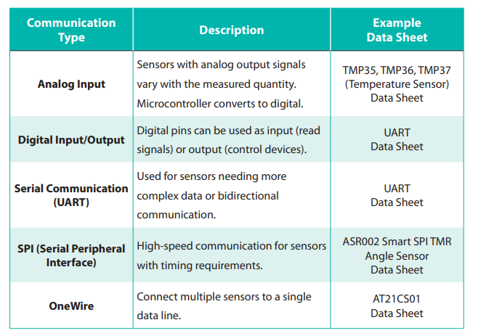
Some common interfaces used to connect sensors to microcontrollers :

Slide 13
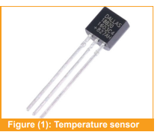
Temperature Sensors:
There are many types of temperature sensors, including thermistors, RTDs, and thermocouples, each with its own advantages and disadvantages.
Temperature sensors are used to measure temperature and are commonly used in applications such as home automation and climate control systems

Slide 14
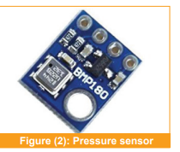
Pressure Sensors:
.They are commonly used in applications, such as industrial control systems and automotive systems
.They could be used to monitor system pressure, control pumps and valves, and provide feedback for control systems.

Slide 15
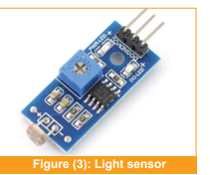
Light Sensors:
Light sensors are used to measure light intensity and are commonly used in applications, such as security systems and automatic lighting systems.
They can be used to detect changes in light levels,
control lighting, and trigger alarms

Slide 16
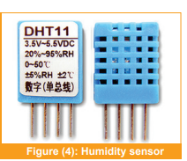
Humidity Sensors:
Humidity sensors are used to measure humidity and are commonly used in applications, such as climate control systems and food storage. They can be used to control humidity levels, detect leaks, and prevent mold and mildew

Slide 17
When selecting a sensor for a microcontroller system, it is critical to consider factors like measurement range, accuracy, and resolution.
Additionally, compatibility with the microcontroller and its associated components should be considered.
Finally, the physical environment in which the sensor will be used should be considered, given that some sensors may be sensitive to temperature, humidity, or other environmental factors.

Slide 18
Simulation Programs
These programs provide a platform for designing, testing, and refining microcontroller-based circuits before building the actual hardware.
Simulation programs allow designers to test various aspects of their design, including the functionality of the microcontroller, the interaction between various components, the behavior of the circuit under different conditions, and the performance of the system.

Slide 19
Some of the most popular simulation programs include Proteus, LTspice, Virtual Breadboard (VBB), CircuitMaker, Multisim, and Simulink.
The choice of the program depends on the specific requirements of the application, the expertise of the designer, and the available resources.

Slide 20
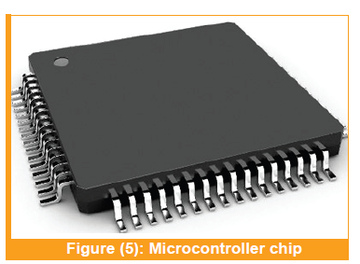
Components of the Microcontroller System
1-Microcontroller Chip:
This is the main component of the system and contains the CPU, memory, and input/output (I/O) peripherals.
A microcontroller chip is a small computer on a single integrated circuit that is designed
to control and interact with other electronic devices or systems.

Slide 21
2- Actuators:
Actuators in a microcontroller system are devices that convert electrical signals generated by the microcontroller into physical action.
Actuators can include motors, servos, and LEDs.
There are many different types of actuators that can be used in a microcontroller system, depending on the specific application requirements.

Slide 22
Some common examples of actuators used in microcontroller systems include:
A) Electric Motors:
Electromechanical devices that convert electrical energy into mechanical energy.
The primary classification of electrical motors consists of three types:
DC Motor
AC Motor
Special Motor

Slide 23
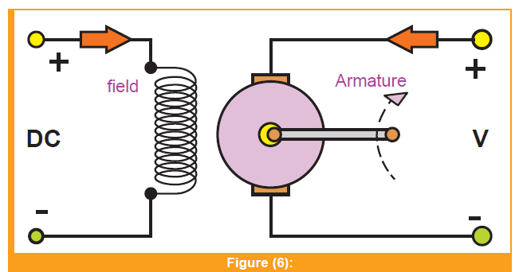
DC Motor
A DC motor is like a magical machine that can turn electrical energy into movement.
It has two main parts: The spinning part (“Wheel”) and the part that creates a
magnetic field (“Magic magnet”).
The wheel is made of special wires that can conduct electricity, which is connected to
something called a “Commutator.”
The commutator resembles a special switch that sends electricity to the right place at the right time. When we give the “wheel” some “magic electricity” using brushes, it starts spinning magically!

Slide 24
There are two basic types:
1. Series Motors 2. Shunt Motors
1-Series Motors:
Imagine the magic magnet and the wheel are connected consecutively in a circle like a chain.
This makes the motor super strong at the start, but it gets a bit wild and hard to control as it spins faster.
So, we use Series Motors for things like toy cars or big machines that need a powerful kick to start, commonly used in various applications, due to their unique characteristics and advantages, such as the following illustrations

Slide 25
Traction Systems:
Series Motors are commonly used in electric traction systems, such as electric trains, trams and trolleys. Their high starting torque and ability to provide constant torque at low speeds make them well-suited for these applications.
Industrial Machines:
Series Motors are used in various industrial machines that require high torque at low speeds. Examples include conveyor belts, cranes, hoists, and printing presses.

Slide 26
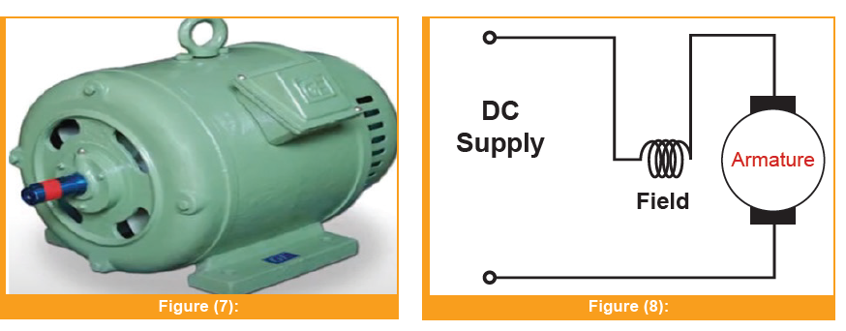
Electric Vehicles :
Series Motors have been historically used in electric vehicles (EVs) and electric cars. However, with advancements in motor technology, other types of motors like permanent magnet motors are more commonly used in modern electric vehicles.
Railway Systems:
Series Motors have been historically
used in various railway systems,
including electric locomotives
and subways.

Slide 27
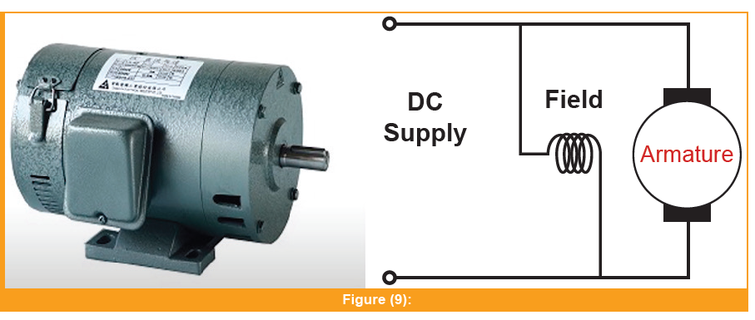
2-Shunt Motors:
In a shunt motor, the magic magnet and the wheel are connected side by side; like best friends.
This makes the motor more stable and easier to control.
Shunt motors are used in devices like fans or tools, where we want a steady and predictable speed. Here are some of the main usages of shunt motors:

Slide 28
Industrial Machinery :
Shunt motors are commonly used in various industrial machinery, such as machine tools, compressors, pumps, and blowers. They offer good speed regulation and stable operation, making them suitable for these applications.
Conveyors and Elevators:
Shunt motors are often used in conveyor systems and elevators, where a steady and controlled motion is required.
Centrifugal Fans:
Shunt motors are used in centrifugal fans, due to their ability to maintain a constant speed even when the load changes.

Slide 29
Textile Industry:
Shunt motors are widely used in the textile industry for spinning, weaving, and winding machines, due to their ability to provide constant speed and smooth operation.
Printing Presses:
Shunt motors are used in printing presses, where consistent speed and accurate control are crucial for producing high-quality prints.

Slide 30
Special motors can be classified into four types:
1. Stepper Motor
2. Servo Motor
3. Universal Motor
4. DC Brushless Motor

Slide 31
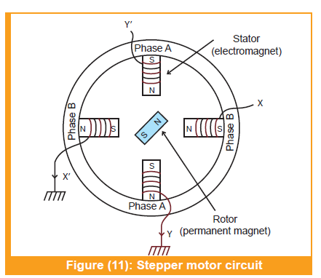
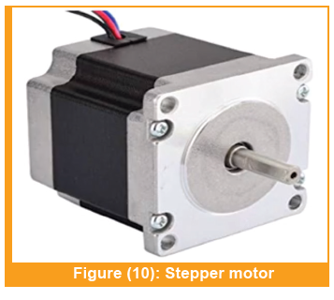
1. Stepper Motor
Stepper motors are DC motors that move in discrete steps.
They have multiple coils organized in groups called “phases.” By energizing each phase in sequence, the motor rotates one step at a time.
Computer-controlled stepping enables precise positioning and speed control.

Slide 32
. Some of the common usages of stepper motors include:
3D Printers:
Stepper motors are commonly used in 3D printers to control the movement of the print head and build platform; ensuring accurate and precise positioning of the print nozzle
CNC Machines:
Computer Numerical Control (CNC) machines use stepper motors to drive the movement of the cutting tool along multiple axes; thus enabling precise machining and milling operations.

Slide 33
Robotics:
Stepper motors are extensively used in robotics for controlling the movement of robotic arms, legs, and joints; allowing for precise and repeatable motions.
Cameras and Optics:
Stepper motors are employed in cameras and optical devices to control focus, zoom, and aperture settings, ensuring smooth and accurate adjustments.
Textile Machines:
Stepper motors are used in textile machines for precise control of thread tension, fabric feed,and other operations.

Slide 34
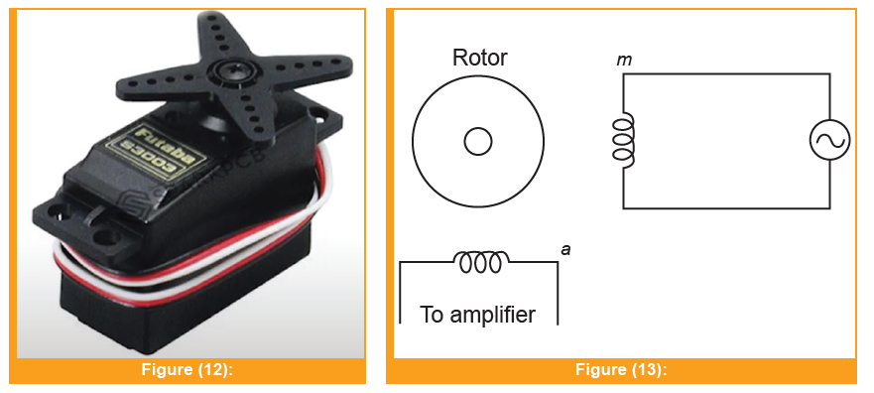
2. Servo Motor
A linear or rotary actuator that enables exact control over acceleration, velocities, and angular or linear positions. It is made up of an appropriate motor connected to a position feedback sensor.
Some of the common usages of stepper motors include:
Camera and Photograph:
Servo motors are employed in camera lenses and gimbals to control focus,
zoom, and stabilization; thus ensuring smooth and accurate adjustments during photography and videography.

Slide 35
Aerospace and Aviation:
Servo motors are used in aircraft control surfaces, such as ailerons, elevators, and rudders, to provide precise and responsive control during flight.
Automotive:
Servo motors are used in various automotive systems, such as power windows, mirrors, and seats, to provide precise and automated adjustments for driver comfort.
Medical Equipment:
Servo motors find applications in medical devices, such as surgical robots and prosthetics, where accurate and controlled motion is crucial for patient safety.

Slide 36
Antenna Tracking Systems:
Servo motors are utilized in antenna tracking systems to precisely align the antenna for optimal signal reception in satellite communication and tracking applications.
HVAC (Heating, Ventilation, and Air Conditioning):
Servo motors are used in HVAC systems to control the position of air dampers and valves, ensuring efficient and precise regulation of airflow and temperature.

Slide 37
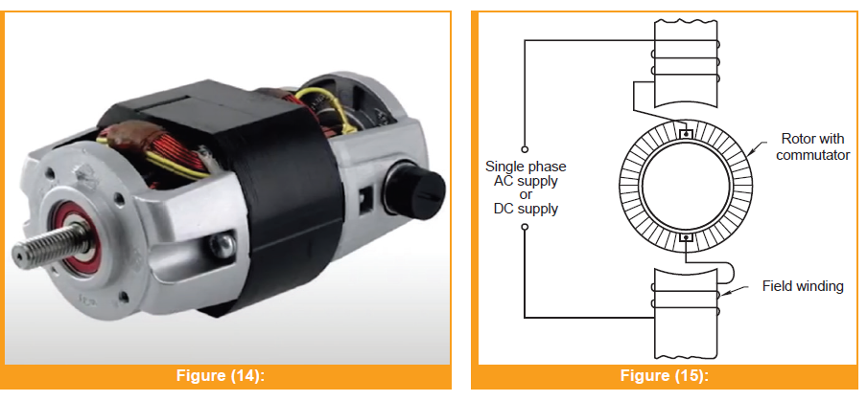
3. Universal Motor
Can operate on AC or DC power. It is a commutated series-wound motor where the stator’s field coils are connected in series with the rotor windings through a commutator. It is often referred to as an “AC series motor”. The universal motor is similar to a DC series motor in construction, but modified slightly to operate properly on AC power.
Some of the common usages of universal motors include:
Electric Fans:
Universal motors are used in
electric fans, where
their ability to run
on both AC and DC power
allows them to be used with different power sources.

Slide 38
Hair Dryers:
Universal motors are utilized in hair dryers due to their compact size and high-speed capabilities, providing the required airflow and heat for drying hair.
Blowers and Extractors:
Universal motors are employed in blowers and extractors used in industries and HVAC systems for moving air and gases.
Sewing Machines:
Universal motors are used in sewing machines to drive the needle and control the stitching speed.

Slide 39
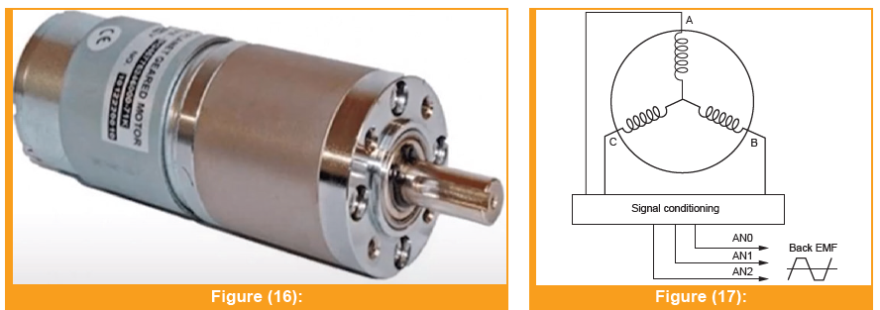
4. DC Brushless Motor
Is a synchronous motor powered by a DC electric source through an integrated inverter or switching power supply. The inverter produces an AC electric signal to drive the motor. In this context, AC current refers to a bidirectional current with no restriction on waveform. Additional sensors and electronics control the inverter output amplitude, waveform, and frequency.

Slide 40
Medical Devices:
DC brushless motors find applications in medical devices like infusion pumps, dental drills, and surgical robots, where precise control and quiet operation are crucial.
Aerospace and Aviation:
DC brushless motors are used in aerospace and aviation applications for actuating control surfaces, landing gear, and other critical functions.
Electric Power Tools:
DC brushless motors are increasingly used in power tools like cordless drills, saws, and grinders, offering longer runtimes and improved performance.

Slide 41
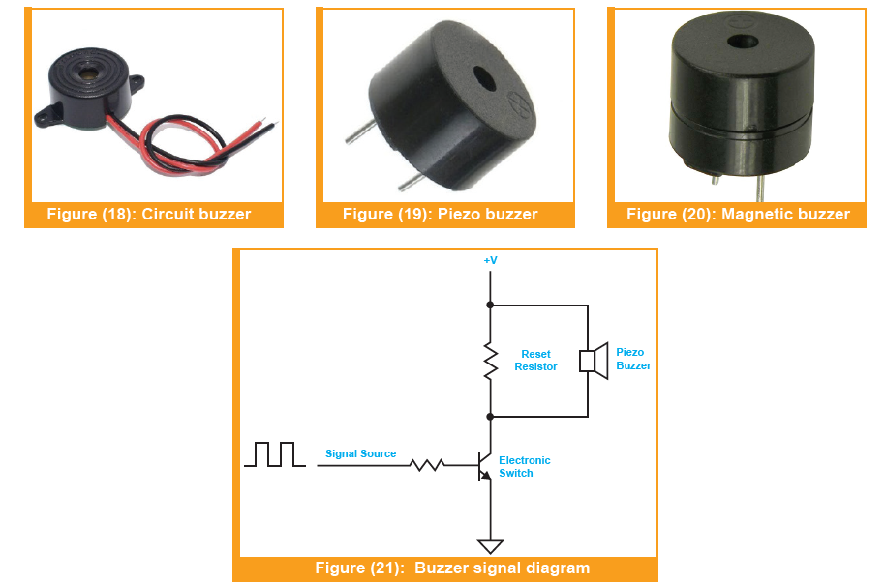
B) Buzzers
Are often used as an audio output device for generating sound alerts, beeps, and tones.
They are a type of transducer that convert electrical energy into sound energy; creating anaudible signal.
In microcontroller systems, buzzers can be implemented in various ways, depending on the application requirements.
Some buzzers are designed to be simple and cost-effective, while others are more sophisticated and provide additional features such as volume control, tone
generation, and multiple sound patterns.

Slide 42
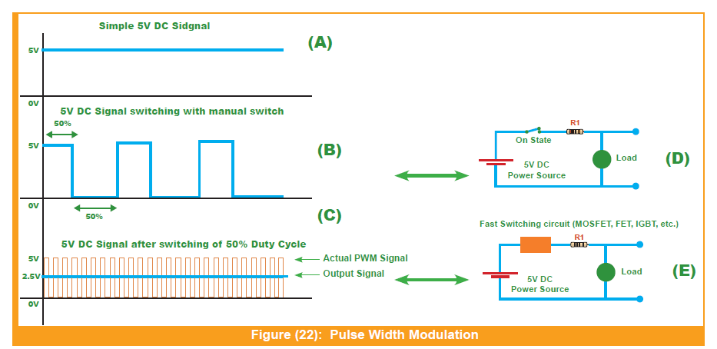
Pulse Width Modulation (PWM)

Slide 43
Duty Cycle:
The percentage for which the signal remains in the ON state within one cycle is called the duty cycle (which we’ll discuss in detail later).
In the example above, the duty cycle of the PWM wave is 50%, which is why its output is exactly half, as we turn it off for the remaining 50%.
PWM Definition:
Pulse Width Modulation (PWM) is a modulation technique used to lower the voltage level (average power) of electrical signals, both AC and DC, by varying their width (ON duration) using fast-switching.

Slide 44
PWM in DC Signals:
Suppose we have a 12V DC power supply, but we want to control a 5V DC load, like an RGB LED, as depicted in the following figure. In Circuit A, there’s a manual switch, and quickly toggling this switch at regular intervals would result in either 12V or 0V at the output.
This abrupt change can potentially damage the LED.
However, in Circuit B, we replace the manual switch with an automatic switch, like a transistor, which enables accurate and fast switching in nanoseconds.
This fast switching maintains a continuous output. If the transistor is ON and OFF for an equal amount of time, the output signal reduces from 12V to 6V, causing the LED to light up. For precise 5V output, the ON period of the transistor must be further reduced.
Two essential factors in PWM are the switching frequency and the duty cycle.

Slide 45
Switching Frequency:
The frequency (or rate) at which the transistor operates is known as the switching frequency.
Typically, microcontrollers or 555 Timers are used to generate PWM pulses. An 8-bit microcontroller can generate a PWM pulse ranging from 4MHz to 80MHz, so, for example, if we’re generating a
20MHz PWM pulse:
t = 1/f
t = 1/20MHz
t = 0.066us
This means the time period of a single PWM pulse is 0.066 microseconds, indicating how fast it switches.

Slide 46
Duty Cycle:
In one cycle of a PWM pulse, the ON period of the pulse is referred to as the duty cycle. For instance, if the transistor is switching at 50%, it means that half of the cycle is ON.
If you’ve worked with a DC motor, you’ve likely noticed that its speed varies with changes in input voltage.
In PWM, electrical signals are passed through fast-switching devices like FETs, MOSFETs, or IGBTs, which are programmed to chop off the electrical signal at regular intervals.
PWM is primarily used to generate an analog signal from a digital source.

Slide 47
It acts as a controller, managing the input current delivered to the load, switching between high (indicating 5V) and low (indicating ground signal) values.
It’s important to note that the high value doesn’t necessarily correspond to 5V
it can vary based on the load’s operating voltage.
The 5V reference is used here to illustrate how PWM alternates between high and low values.
PWM operates as a controlled switch that regulates the current delivered to the load.
When the switch is off, no current is available for the load, and when it’s on, power is delivered to the load with no voltage drop
PWM controllers are essential where minimizing power losses by delivering power
to the load in pulses is preferred over continuous supply.

Slide 48
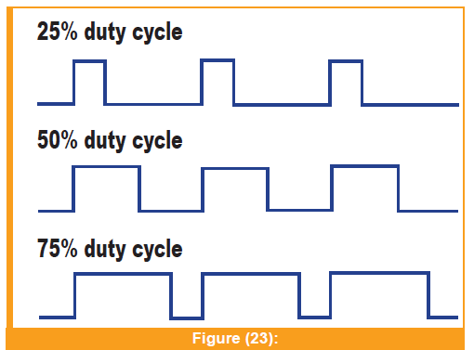
PWM can be defined by the duty cycle and the frequency at which the duty cycle repeats each second.
The duty cycle represents the amount of time the signal switches between the ON and OFF positions, expressed as a percentage.
If the signal remains ON for half of the total duty cycle and OFF for the other half, the duty cycle is 50%.

Slide 49
PWM and Motor Control:
the motor’s speed is directly proportional to the duration of the ON signal within the duty cycle. A longer ON duration results in faster motor rotation, while a longer OFF duration leads to slower motor speed.
Using PWM for motor control offers advantages over simply varying the analog signal to the motor.
PWM, on the other hand, delivers power in pulses, ensuring the motor terminals are either fully ON or OFF.

Slide 50
LED Example:
Controlling an RGB LED is an excellent example to grasp the concept of PWM.
By adjusting the duty cycle of each color and playing with their brightness, you can
achieve specific colors. To avoid creating white light,
it’s essential to vary the duty cycle differently for each color.
For instance, applying red light with a 10% duty cycle at 2 MHz speed means the red light will mostly be OFF. In contrast,
applying the same with a 10% duty cycle at 100 MHz increases the contribution of the red light to the LED’s display.

Slide 51
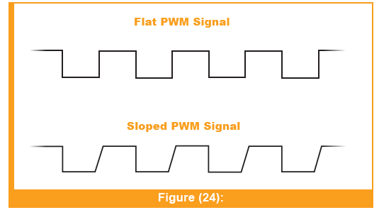
Computer Motherboard:
Computer motherboards employ PWM signals to control the fans, providing power in pulses.
Continuous power delivery without PWM could harm the board, as the fan would run at full speed without interruptions.
Some computer fans come with IC drive chips to ensure silent operation. It’s worth noting that PWM generated with a sloped duty cycle is preferred over a flat one, as the latter can produce a clicking sound at low fan speeds
High duty cycles make the fan run at full speed,
resulting in an unpleasant ticking sound.
To avoid this, high-quality PWM fans with
IC drive chips are available,
offering a silent and efficient solution that can extend the lifespan of the motherboard

Slide 52
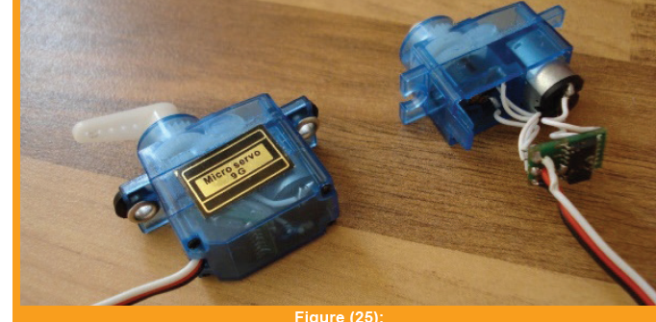
PWM for Servo Control:
Servos play a crucial role in various applications, providing precise control over mechanical movements.
They typically consist of a motor, a potentiometer, and control electronics.
The potentiometer helps determine the servo’s current angle, enabling closed-loop servomechanism.
Servo control involves using
a square wave signal as input
to drive the servo to the desired angle.

Slide 53
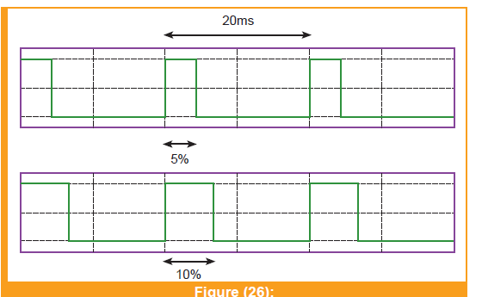
For servo control, the signal has a fixed frequency, while the duty cycle varies.
Servos commonly accept a control signal in the form of a square wave with a repeating frequency of 20ms and an “on” period ranging from 1ms (5%) to 2ms (10%).
The duration of the “on” pulse specifies the angle at which the servo should be positioned.

Slide 54
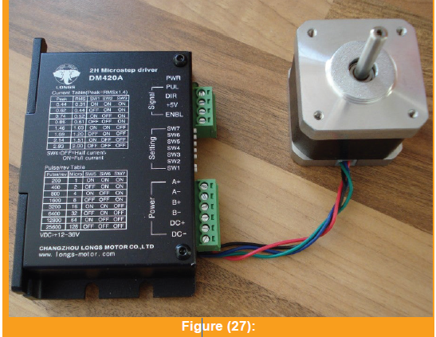
PWM for Stepper Motors:
Stepper motors are brushless DC electric motors designed to divide a full rotation into a specific number of steps.
The position of these motors can be precisely determined by counting the number of steps commanded, providing open-loop control over the system.
Typically, a stepper motor driver is incorporated into the system to both power the motor and simplify control through step and direction pulses.
With each pulse on the step line,
the motor advances one step
or part step in a specified direction.

Slide 55
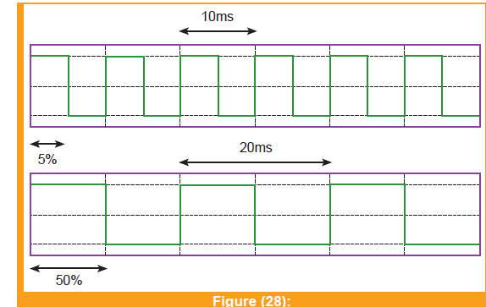
For controlling stepper motors with a driver, the duty cycle can remain fixed, while the frequency is varied.
The stepper motor driver expects a sequence of input pulses to move the motor to a desired angle, with each pulse corresponding to one step of movement.
The direction in which the motor moves is determined by the second input.

Slide 56
PWM for buzzers:
Think of a buzzer as a device that can be turned on and off really quickly, much faster than our eyes can catch.
In PWM, we control the buzzer by changing how long it’s on (the “duty cycle”) and how long it’s off within a fixed period (the “frequency”).
Duty Cycle:
The duty cycle is the part of the time the buzzer is ON during each cycle. If the duty cycle is 50%, it means the buzzer is ON half the time and OFF the other half. This might produce a medium-loud sound.
Frequency:
The frequency is how quickly these cycles happen in a second. For example, if there are 1000 cycles in one second, the buzzer is switching on and off very rapidly.

Slide 57
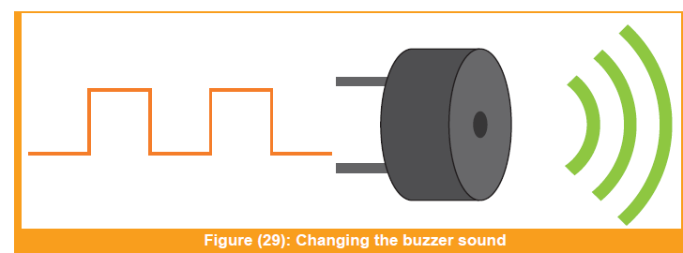
Changing the Sound:
To change the sound a buzzer makes, we can adjust the duty cycle and frequency. For example:
Loud Sound: Increase the duty cycle (make it ON longer) and keep a high frequency (many cycles per second).
Soft Sound: Reduce the duty cycle (make it ON briefly) and maintain a high frequency.
High-Pitched Sound: Keep the duty cycle the same but increase the frequency.
Low-Pitched Sound: Keep the duty cycle the same but decrease the frequency.

Slide 58
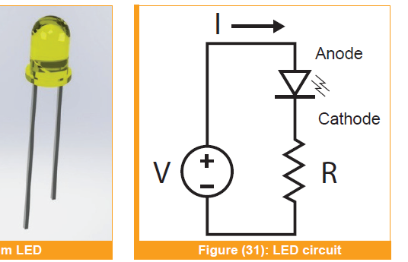
3- LEDs
LEDs (Light-Emitting Diodes) are commonly used as output devices in microcontroller systems to indicate the status of the system, provide feedback to the user, or simply act as a visual indicator.
They are connected to the microcontroller output pins through a current-limiting resistor, which protects the LED from damage due to excessive current.
LEDs can be controlled in various ways,
such as by turning them on or off,
or varying their brightness using PWM
. They can be used in various applications,
such as in traffic lights, electronic displays, and backlights for LCD screens.

Slide 59
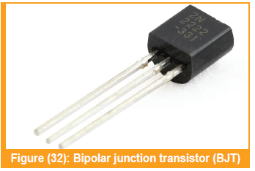
4- Transistors
In a microcontroller system, transistors are used to control the flow of current or voltage to different components.
There are two types of transistors commonly used in microcontroller systems:
Bipolar Junction Transistors (BJTs):
are versatile semiconductor devices that find numerous applications in electronic circuits. Some common uses of BJTs include:

Slide 60
Amplification:
BJTs are widely used as voltage and current amplifiers in electronic circuits.
They can amplify weak signals to a higher level, making them essential in audio amplifiers, radio receivers, and signal processing circuits.
Switching:
BJTs are commonly used as switches in digital logic circuits and power control applications.
They can be used to turn on and off high-current loads, such as motors and relays, in response to small control signals.

Slide 61
Oscillators:
BJTs are used in oscillator circuits that generate periodic waveforms, such as sine waves, square waves, and pulse waves. Oscillators are found in clock generators, signal generators, and communication systems.
Current Regulation:
BJTs can be used as constant current sources or current mirrors, ensuring a stable and regulated current flow in various electronic circuits.

Slide 62
Voltage Regulation:
BJTs are used in voltage regulator circuits to maintain a constant output voltage regardless of variations in input voltage or load current.
Differential Amplifiers:
BJTs are employed in differential amplifier configurations, which are widely used in operational amplifiers (op-amps), communication circuits, and instrumentation circuits.

Slide 63
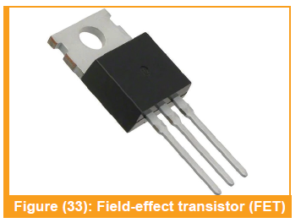
2. Field-Effect Transistors (FETs):
are semiconductor devices widely used in various electronic circuits due to their versatility and excellent performance characteristics.
Some of the common applications of FETs include:
Oscillators:
Radio Frequency (RF) Applications:
FETs are widely used in RF amplifiers, mixers, and frequency converters in communication systems and radar applications.

Slide 64
Low-Noise Applications:
FETs are preferred in applications where low noise is critical, such as in high-fidelity audio amplifiers and sensitive measurement equipment.
High-Frequency Applications:
FETs are favored in high-frequency circuits due to their ability to operate at higher frequencies with low power dissipation.
High-Power Applications:
FETs, especially power MOSFETs, are used in high-power applications; including motor drives, power inverters, and power supplies.

Slide 65
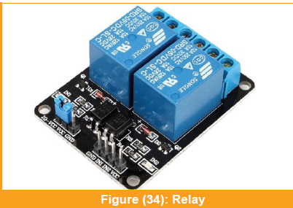
5- Relay
An electromechanical device that is used to control larger electrical loads or devices using the low-power signals and outputs of a microcontroller.
A relay consists of an electromagnet, which is energized when a small electrical current flow through it. When the electromagnet is energized, it generates a magnetic field that attracts a movable contact, closing or opening the circuit. This allows the relay to control the flow of a larger electrical current or voltage that the microcontroller itself cannot handle directly.

Slide 66
6- Development board
A development board is a necessary piece of equipment for any microcontroller user. It’s a circuit board that provides an easy-to-use platform for building, testing, and experimenting with microcontroller-based projects.
A development board usually includes a microcontroller chip, input/output pins, power supply, and communication interfaces.
Some of the most popular microcontroller chips used in development boards include the Arduino, Raspberry Pi, and ESP8266. These boards provide a cost-effective way to prototype and develop projects using these popular microcontrollers.

Slide 67
The most significant advantages of development boards are:
Their ease of use. They typically come with all the necessary components pre-installed, including a bootloader, software development environment, and programming tools.
Their flexibility: They often come with a wide range of input and output pins, allowing users to connect a wide range of sensors, actuators, and other components to the microcontroller.
Development boards also provide a low-risk platform for experimentation, since they are relatively inexpensive, users can experiment with different hardware configurations and software without worrying about damaging expensive equipment.

Slide 68
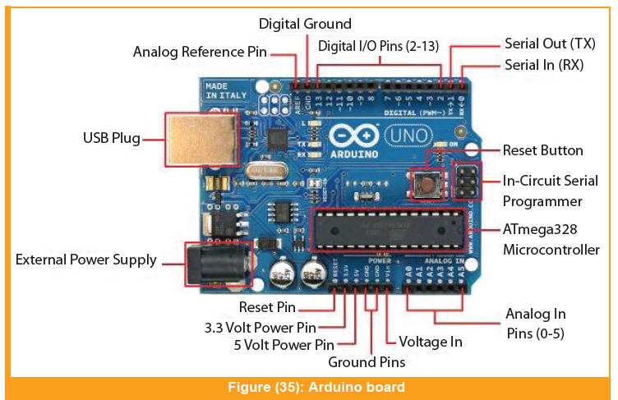
1. Arduino Boards:
Arduino boards are a popular choice for hobbyists and beginners due to their ease of use and compatibility with a wide range of sensors and modules. These boards are based on the Atmel AVR microcontroller and come with a built-in USB interface, allowing for easy programming and debugging.

Slide 69
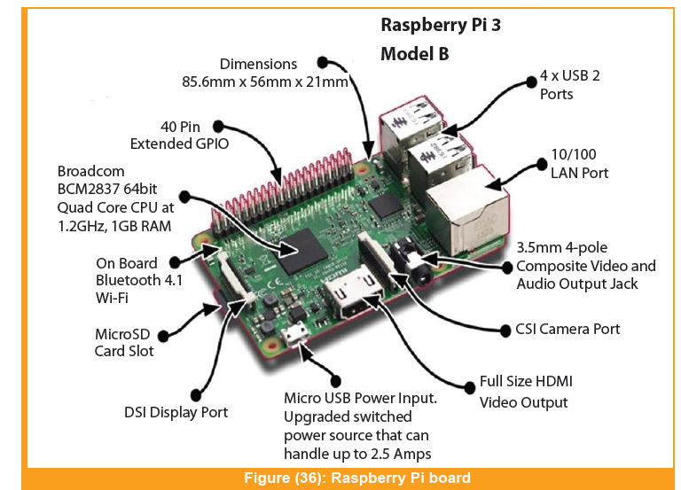
2. Raspberry Pi Boards:
Raspberry Pi boards are small, single-board computers that are used for a wide range of applications, including IoT projects, automation systems, and robotics. These boards are equipped with a Broadcom system-on-chip (SoC) and come with a variety of connectivity options, including Wi-Fi and Bluetooth.

Slide 70
Tools and Devices for Working with Microcontroller Systems
Encoding Software for the Microcontroller Systems:
It allows programmers to write codes and instructions for the microcontroller to execute specific tasks.
Some popular examples include Arduino (IDE), MPLAB, Keil, and Atmel Studio (AVR).
Arduino Integrated Development Environment (IDE):
is an open-source software application that is widely used in the microcontroller community for programming and debugging microcontrollers, particularly those based on the Arduino platform

Slide 71
The IDE includes a code editor, a compiler, and a debugger, as well as a range of built-in libraries and example codes to help users get started with programming microcontrollers.
The compiler translates the written code into machine code that the microcontroller can understand, while the debugger allows users to step through their code line by line, set breakpoints, and monitor variables and memory usage.

Slide 72
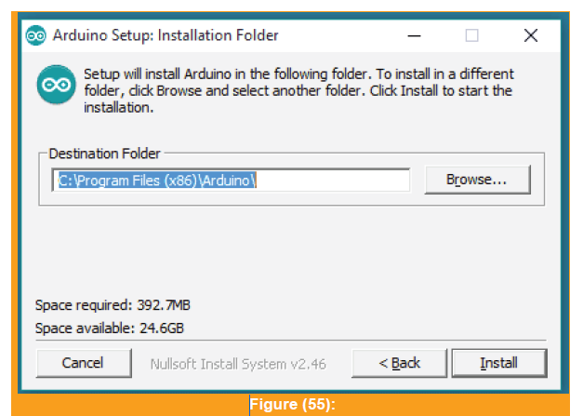
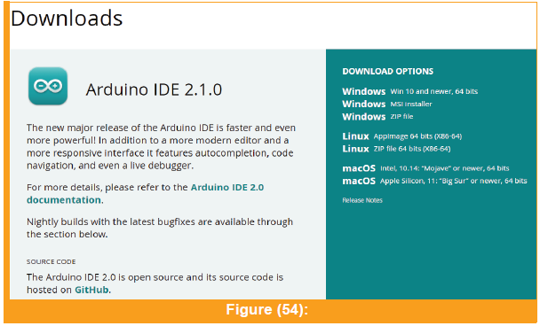
To prepare the Arduino IDE, you can follow these instructions:
Download the Arduino IDE: Go to the official website of Arduino (https://www.arduino.cc/en/software) and download the latest version of the Arduino IDE that is compatible with your computer’s operating system.

Slide 73
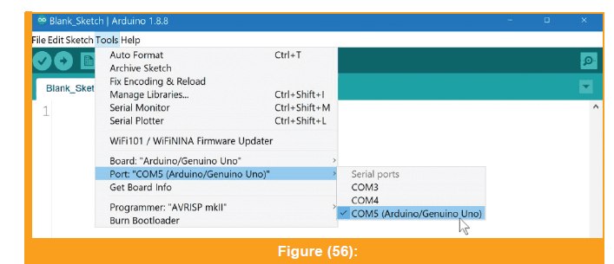
Install the Arduino IDE: Once the download is complete, run the setup file and follow the installation wizard. The installation process is straightforward and you can choose the installation location and options according to your preferences.
Configure the Arduino IDE:
After the installation is complete,
open the Arduino IDE. You need to configure some settings before you start coding.
In the “Tools” menu, select the board and the port you want to use. If you are using an Arduino board, select the Board Model from the “Boards” submenu.
Then, select the correct serial port from the “Port” submenu.

Slide 74
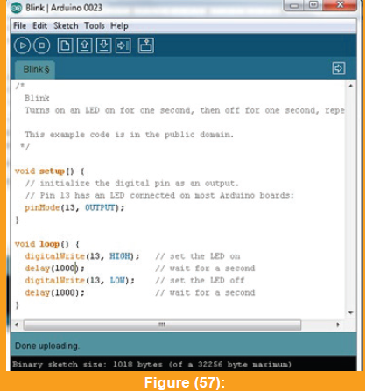
Start coding: Now you can start writing code for your project in the Arduino IDE. You can use the built-in examples to learn how to use the different functions and libraries. When you finish writing your code, save it to your computer

Slide 75
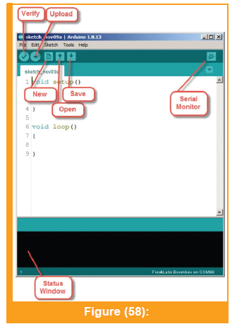
Verify and upload the code: Before you upload the code to the microcontroller, you need to verify it to check for errors. In the “Sketch” menu, select “Verify/Compile” to compile the code and check for errors. If there are no errors, you can upload the code to the microcontroller. Connect the microcontroller to your computer, select the correct board and port,
and click the “Upload” button in the Arduino IDE.
The code will be compiled and uploaded
to the microcontroller.

Slide 76
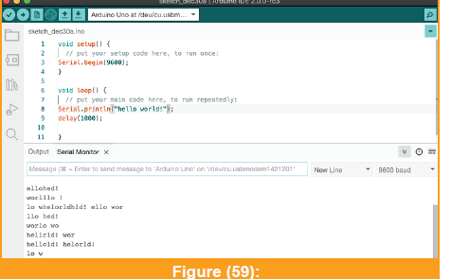
Test the code: Once the code is uploaded, you can test your project by connecting the necessary components to the microcontroller. You can use the built-in serial monitor to check the output of your program.

Slide 77
2. MPLAB:
Is a software development tool used to program and debug Microchip’s PIC microcontrollers
MPLAB is widely used by engineers and hobbyists alike to develop microcontroller-based applications.
One of the key features of MPLAB is its ability to provide a real-time view of the microcontroller’s internal registers and memory. This allows developers to quickly test and debug their code, and to identify and fix errors as they occur.
MPLAB is compatible with a range of programming languages, including C, C++, and Assembly – making it a versatile tool for developing microcontroller-based applications.

Slide 78
Burning Software for Microcontroller Systems
Burning software for microcontroller systems is used to transfer the compiled code from the computer to the microcontroller for it to execute.
Some of the most commonly used burning software programs for microcontroller systems include AVRDUDE, MPlap, and PICkit.

Slide 79
1. AVRDUDE:
An open-source programming tool used to transfer programs from a computer to AVR microcontrollers.
AVRDUDE can program various types of memories, including flash memory, EEPROM, fuses, and lock bits.
AVRDUDE is a command-line tool, which means that it is operated through a terminal or command prompt.
AVRDUDE can be used in conjunction with several popular programming environments, including the Arduino IDE and Atmel Studio. When using the Arduino IDE, the AVRDUDE tool is used to upload compiled programs to the Arduino board. In Atmel Studio, AVRDUDE is used as the back-end tool for programming AVR microcontrollers.

Slide 80
2. PICkit:
They are used to program and debug Microchip’s range of PIC microcontrollers, dsPIC digital signal controllers, and some memory chips
PICkit programmers provide a simple and cost-effective way to program and debug embedded applications on target hardware. They are also used to test and debug digital and analog circuits on breadboards or PCBs.
The PICkit programmers connect to the target device via a six-pin ICSP connector or a two-pin ICSP connector ,They also have a USB interface for connecting to a computer
The PICkit programmers can be used to program and debug both small and large microcontroller-based projects, making them a popular choice among hobbyists and professionals alike.

Slide 81
Measuring Devices for Microcontroller Systems:
Measuring devices are important tools for microcontroller systems that help in analyzing and understanding the behavior of electronic circuits.
1. Multimeter:
A multimeter is a measuring device that is used to measure various electrical quantities such as voltage, current, and resistance. It has two probes, one red and one black that are used to make contact with the circuit being measured. The multimeter can then display the measured value on a digital or analog screen.
Logic Analyzer: A logic analyzer is a device that captures and analyzes digital signals in a circuit. It is used to debug digital circuits and analyze digital communication protocols.

Slide 82
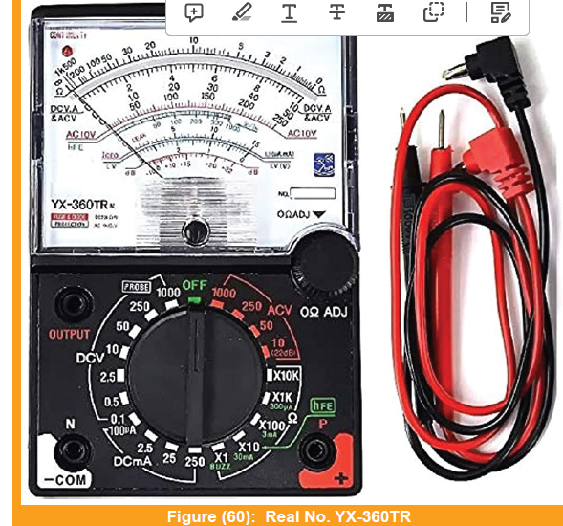
Analog Multimeter:
This type of multimeter has a scale and a moving pointer that indicates the measured value. It usually has a rotary switch to select the measurement type, such as voltage, current, or resistance.

Slide 83
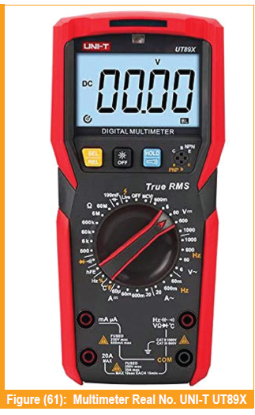
Digital Multimeter:
This type of multimeter displays the measured value as a numerical digit on a digital screen. It also has a rotary switch to select the measurement type, and some models may have additional features such as auto-ranging or data logging.

Slide 84
2. Oscilloscope:
An oscilloscope is an electronic instrument used for observing and analyzing electrical signals.
It allows you to see the voltage of a signal over time, which can help you understand how a circuit is working and identify any issues or abnormalities

Slide 85
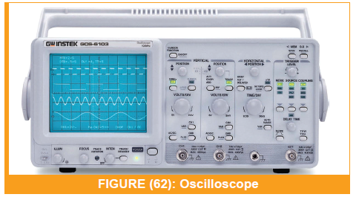
Analog oscilloscopes:
work by using an electron beam to trace a waveform onto a screen. The position of the beam is controlled by the input signal and the deflection plates inside the oscilloscope. This produces a continuous waveform that is displayed on the screen.

Slide 86
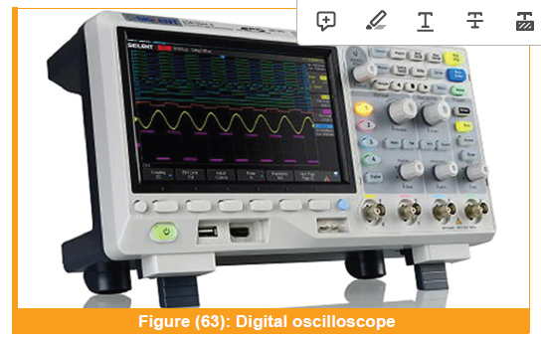
Digital oscilloscopes:
use an analog-to-digital converter (ADC) to sample the input signal and convert it into a digital waveform that can be displayed on a screen. They can also perform advanced signal processing functions and have additional features like automatic measurements, signal generators, and more.

Slide 87
Types and Capabilities of Different Programmable Integrated Circuits.
Arduino Family:
These microcontrollers are based on Atmel AVR processors and are programmed using the Arduino Integrated Development Environment (IDE)
The Arduino family includes a wide range of boards, each with different capabilities and features. For example, the Arduino Uno is a popular board that features 14 digital input/output pins, 6 analog input pins, and a 16 MHz clock speed. The Arduino Mega is a larger board with 54 digital input/output pins, 16 analog input pins, and a 16 MHz clock speed.

Slide 88
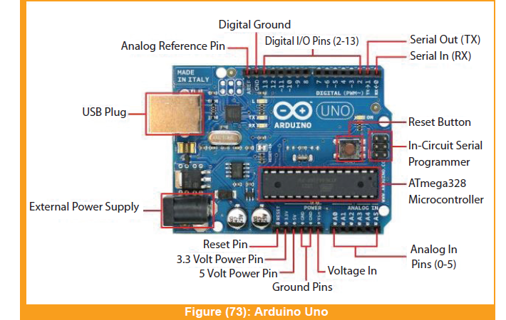
1. Arduino Uno:
It is based on the ATmega328P microcontroller chip and comes with a variety of input/output pins that can be used to connect various sensors, displays, and other electronic components
The board has a USB interface that allows it to be easily connected to a computer for programming and communication.
It also has an onboard power regulator
that can be used to power the board
through a USB cable
or an external power source.

Slide 89
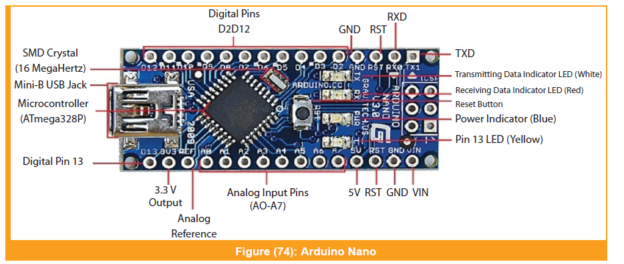
2. Arduino Nano:
A small-sized microcontroller board that is based on the ATmega328P microcontroller. It is similar to the Arduino Uno, but in a smaller form factor.
The Arduino Nano board has 14 digital input/output pins, 8 analog inputs, and 6 pulse width modulation(PWM) pins
The small size and low cost of the Arduino Nano make it ideal for projects where space and budget are limited. It can be used in a wide range of projects; including robotics, home automation, and wearable technology.

Slide 90
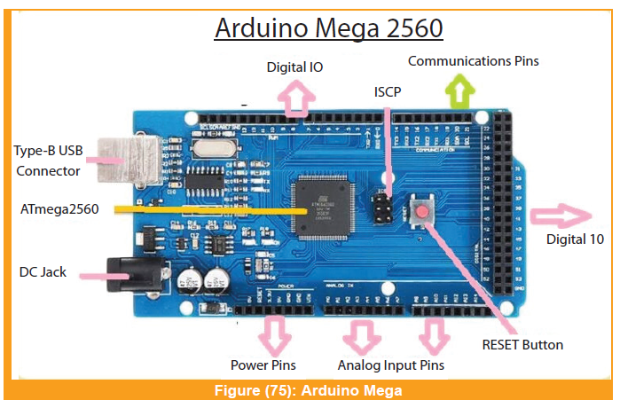
3. Arduino Mega:
The ATmega2560 microcontroller is the foundation for the Arduino Mega microcontroller board. It is an advanced version of the Arduino Uno board, providing more input/output (I/O) pins, memory, and processing power This allows for more complex projects to be developed and executed on the board.
The Arduino Mega board also features a USB port for connection to a computer for programming and communication, as well as a power jack and a reset button. It is a great choice for projects that require more I/O pins, memory, or processing power than what the Arduino Uno board can provide.

Slide 91
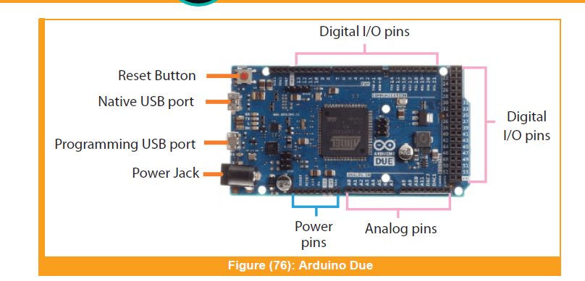
4. Arduino Due:
Arduino Due is a microcontroller board based on the Atmel SAM3X8E ARM Cortex-M3 CPU. It is a powerful board that has 54 digital input/output pins, 12 analog inputs, 4 UARTs (hardware serial ports), an 84 MHz clock, 2 DAC (digital to analog converter), 2 USB ports, and more. It also has a built-in USB host that allows it to act as a USB device, like a mouse or a keyboard, and communicate with other USB devices.
It is commonly used in robotics,automation, and other projects that require real-time processing and communication with other devices.

Slide 92
B) The PIC Family
Some of the most popular PIC microcontrollers include the PIC16F877A and the PIC18F4550. These microcontrollers are easy to use and can be programmed using the MPLAB Integrated Development Environment (IDE).
The PIC family of microcontrollers is known for its low power consumption and high performance, which are widely used in various embedded applications.

Slide 93
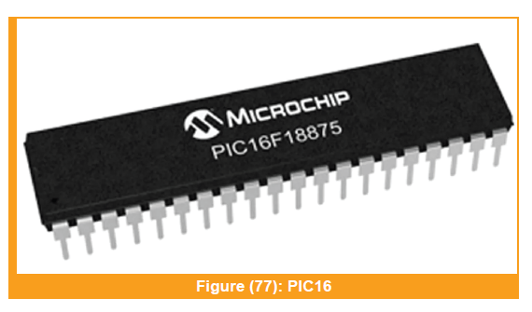
1. PIC16:
These are mid-range microcontrollers with more memory, higher processing power, and more peripheral options than the PIC12 series. They are suitable for a wide range of applications, including industrial automation, automotive, and consumer electronics.

Slide 94
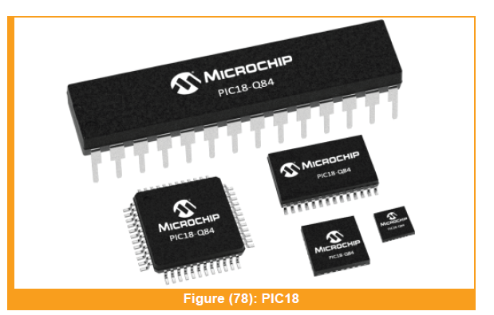
2. PIC18:
These microcontrollers have even more processing power, memory, and peripherals than the PIC16 series, making them suitable for complex applications that require advanced features.

Slide 95
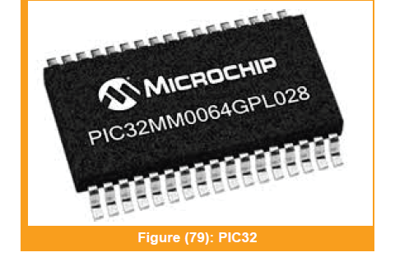
3. PIC32:
These microcontrollers are based on a 32-bit architecture, which provides higher performance and more memory than the 8-bit PIC microcontrollers. They are suitable for applications that require advanced features, such as high-speed communication and multimedia processing.

Slide 96
C )The ARM Family
Some of the most popular ARM microcontrollers include the STM32 series and the LPC1768. These microcontrollers are powerful and efficient, with clock speeds ranging from 72 MHz to 180 MHz. They can be programmed using a variety of development tools, including the Keil μVision (IDE) and the Eclipse IDE.
The ARM family of microcontrollers is a popular choice for various embedded applications due to their high performance, low power consumption, and flexible design.

Slide 97
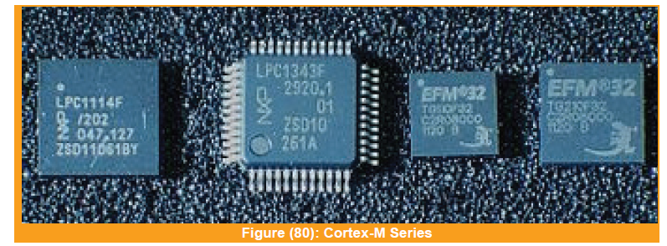
1. Cortex-M Series:
This series is designed for use in low-power, cost-sensitive embedded applications. It includes several sub-families, such as the Cortex-M0, Cortex-M3, and Cortex-M4, which differ in terms of their performance, power consumption, and peripheral integration.

Slide 98
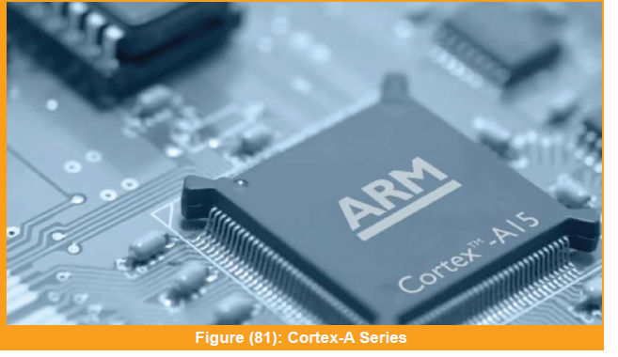
2. Cortex-A Series:
This series is designed for use in high-performance, complex applications such as smartphones, tablets, and automotive systems. They offer high-speed processing, advanced memory management, and multimedia capabilities.

Slide 99
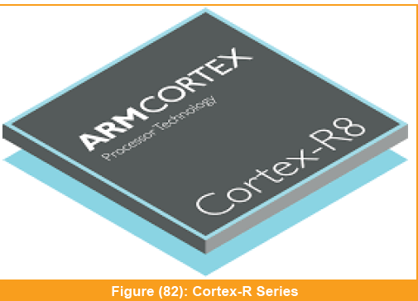
3. Cortex-R Series:
This series is designed for use in real-time, safety-critical applications such as medical devices, automotive safety systems, and industrial automation. They offer deterministic processing, advanced memory protection, and error-correcting code (ECC) support.

Slide 100
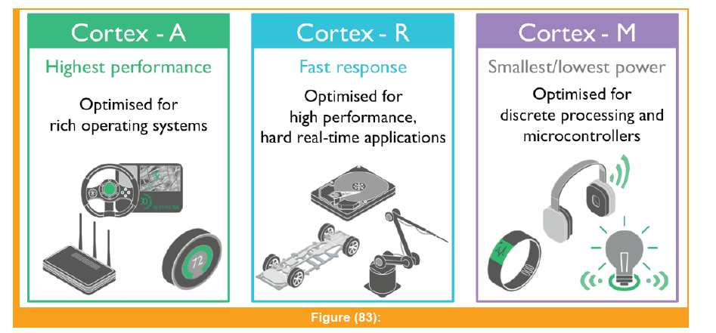

Slide 101

D) The Atmel Family
The Atmel family, also known as Atmel AVR (Advanced Virtual RISC) microcontrollers, is a popular and widely used family of microcontrollers in the embedded systems and electronics industry.
ATmega328P:
One of the most widely used microcontrollers, found on the Arduino Uno board and many other development boards.

Slide 102


ATmega2560:
Offers more I/O pins and memory than the ATmega328P, commonly found on Arduino Mega and other advanced projects.
ATtiny85:
A compact and low-cost microcontroller suitable for
small-scale projects withlimited requirements

Slide 103


Slide 104


Slide 105
Development of Microcontroller Systems

Slide 106
Introduction:
First, you need to determine the type of microcontroller that you will use based on the requirements of your project
you need to choose the necessary electronic tools and components needed to build the system. This could include items such as breadboards, resistors, capacitors, sensors, and actuators.
the next step is to design the system on a simulation program. This allows you to test the system virtually before building it in real life
it is important to document your plan and design in a way that allows for future reference. This could involve creating schematics, flowcharts, or written documentation that outlines the design and the steps required to build it.

Slide 107
Determining the Type of Microcontroller Based on Requirements
1 )Understanding the Requirements of the Project:
Introduction to understanding project requirements:
Understanding the requirements of the project is the first step in preparing for the creation of a simple system using a microcontroller. It involves identifying the purpose of the project, the specific tasks it needs to perform, and the environment in which it will operate.

Slide 108

B )Overview of common types of requirements:
Requirements can be categorized into several different types, including:

Slide 109
For Example:
Goals:
To create a system that can monitor and control temperature and humidity levels in a greenhouse.
To build a robot that can navigate a maze and perform certain tasks.
Constraints:
Limited budget for the project.
Limited access to certain electronic components or tools.

Slide 110

Selecting Electronic Tools and Components Based on Requirements
1) Identifying the Necessary Electronic Tools and Components Required for the Project:

Slide 111
Designing the System on a Simulation Program
Proteus is one of the several software tools available for this purpose.
Proteus is an electronic design and simulation tool created by Lab Center Electronics.
It serves as a valuable tool for ensuring the functionality of circuit designs and firmware code before physical implementation begins.
One of the notable advantages of Proteus is its extensive library of components, enabling users to virtually design their circuits. The software also provides useful features, such as virtual meters (voltmeter and ammeter), an oscilloscope, a serial monitor, and more, facilitating easy compilation and debugging of designs.

Slide 112

1) Getting Started with Proteus

Slide 113


Slide 114


Slide 115


Slide 116


Slide 117

2)Simulating Arduino Projects Using Proteus
It focuses on the simulation of a seven-segment display and a DC motor by establishing an interface between the components.

Slide 118


Slide 119

Interfacing a Seven-segment Display to Perform Up-counting
A seven-segment display, as the name implies, consists of 7 LEDs used to display letters and numbers. Additionally, it contains a dp LED, a tiny dot LED.

Slide 120

All LEDs in a seven-segment display are named alphabetically, making it very easy for a programmer to display a number or alphabet.
All LEDs should now be connected to the Arduino's digital pins. An LED will turn ON when the digital Write function returns a HIGH state, and vice versa. The chart below shows how to display numbers using a seven-segment common cathode LED.

Slide 121

Interfacing a DC Motor With Arduino Using an L293D IC
You can use Proteus to emulate a DC motor in this activity, then use the oscilloscope to view PWM waves. To modify the speed of the DC motor, an Arduino PWM signal is necessary
PWM Signal Characteristics: The oscilloscope displays the PWM signal generated by the Arduino. Participants should observe the waveform, which consists of a series of high and low voltage levels. The duration of the high voltage level represents the “ON” time, while the low voltage level represents the “OFF” time.

Slide 122
Duty Cycle: Participants can measure the duty cycle of the PWM signal using the oscilloscope. The duty cycle is the percentage of time the PWM signal remains in the high state during one cycle. It directly correlates to the speed of the DC motor. A higher duty cycle means a longer ON time, resulting in a faster motor speed.
Pulse Frequency: The frequency of the PWM signal is the number of cycles per second. Participants can determine the pulse frequency from the oscilloscope. It influences the smoothness and responsiveness of the motor’s speed control. Higher pulse frequencie result in smoother motor operation.

Slide 123
Effect on DC Motor: By adjusting the PWM duty cycle using the Arduino, participants can observe how the motor’s speed changes accordingly. A higher-duty cycle drives the motor faster, while a lower-duty cycle slows it down. Participants can witness this relationship between PWM duty cycle and motor speed in real-time on the oscilloscope
Signal Stability: The oscilloscope allows participants to verify the stability and accuracy of the PWM signal. A stable and well-defined PWM waveform is crucial for precise motor speed control. Any irregularities or noise in the signal can affect the motor’s performance

Slide 124



Slide 125
What is an L293D IC? Why is it Used?
Arduino is not sufficient to drive the DC motor directly, as the motor consumes more current. Arduino can source 40mA (max) from its GPIOs and a DC motor requires up to 200 - 300 mA. So, current amplification between the Arduino and the DC motor is required. That is where the L293D IC H-bridge driver comes in.
The fundamental benefit of an H-bridge is that it requires a simply change in current direction rather than a change in voltage polarity to drive the motor forward or backward

Slide 126

Two H-bridge diagrams are shown below, each with different current directions. In image A, turning the first and second transistors on causes the motor to turn clockwise. In image B, turning the third and fourth transistors on will cause it to turn counter-clockwise

Slide 127

It requires two Vcc’s: 5V (Vcc1) for its internal driver operation and 12V (Vcc2) for the motor. The L293D can drive two motors at a time and for each motor, it has two input pins (A) and two output pins (Y). We must send a HIGH digital signal to one input pin and a LOW digital signal to the other. The motor will then receive these impulses after they have been amplified. In essence, we just applied a HIGH signal to one pin of the motor and a POSSIBLE signal to another pin of the motor. This will typically cause the motor to run constantly at its fastest speed in one direction.
However,we will use PWM pulses from Arduino to activate
the L293D's pin in order to assign speed.

Slide 128
Programming the Arduino and DC Motor
In terms of programming, you must command a motor to go in a specific direction and give it a steady speed. The code is rather simple to understand. digitalWrite(7,HIGH); //Move motor in clockwise direction
digitalWrite(6,LOW);
analogWrite(9,100); //speed
Upload the hex file of this code to the Arduino board and watch the motor rotate in the simulation.

